Slide 1
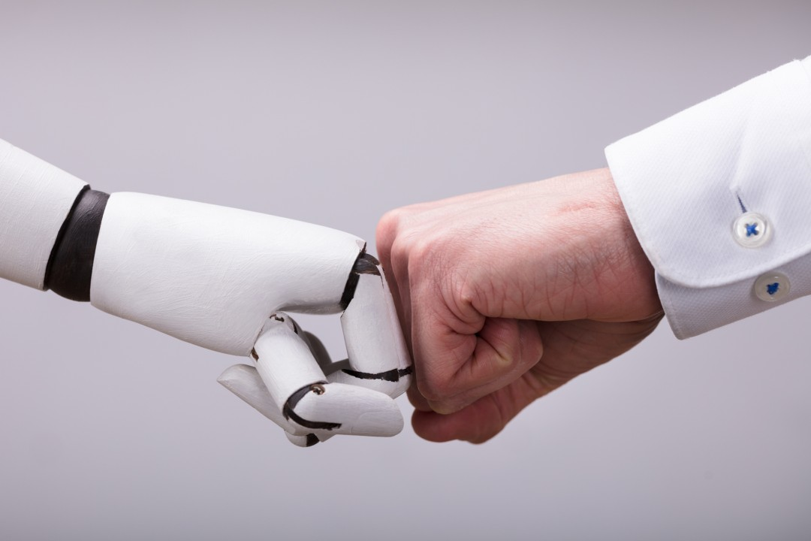
AI Doctor Assistant
Company : RAMAN-AI-MED

Slide 2


problem
Time Constraints :
Doctors often have limited time with each patient, which can hinder thorough examinations and discussions about treatment options.
Medical Errors:
Mistakes in diagnosis, treatment, or communication can occur, leading to adverse outcomes for patients.
Technological Integration:
Keeping up with rapidly evolving medical technologies and incorporating them into practice can be daunting.

Slide 3
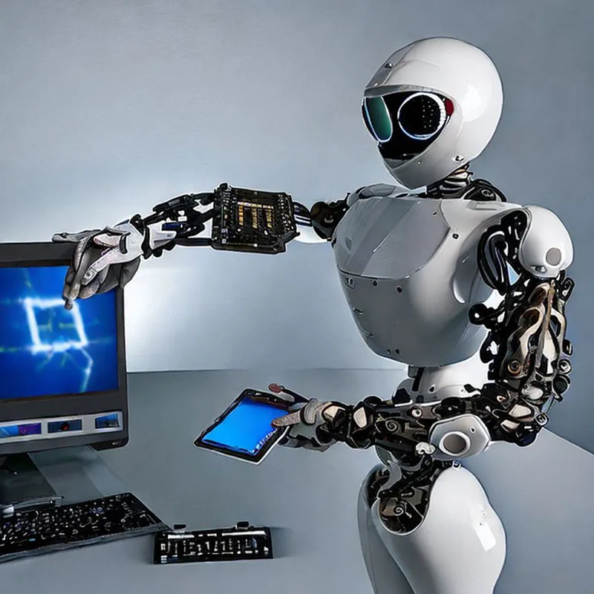
solution
Determining the appropriate drug dosage for each patient based on their medical history
Diagnostic Accuracy
Clinical Decision Support
Predictive Analytics
Drug Discovery and Development

Slide 4

specifications and features
Advanced Diagnostic Capabilities
Drug Dosage Calculation and Adjustment
Treatment Duration Optimization
Security and Privacy Compliance
Personalized Treatment Recommendations
User-Friendly Interface and Accessibility
Continuous Learning and Improvement
Clinical Decision Support System (CDSS)

Slide 5
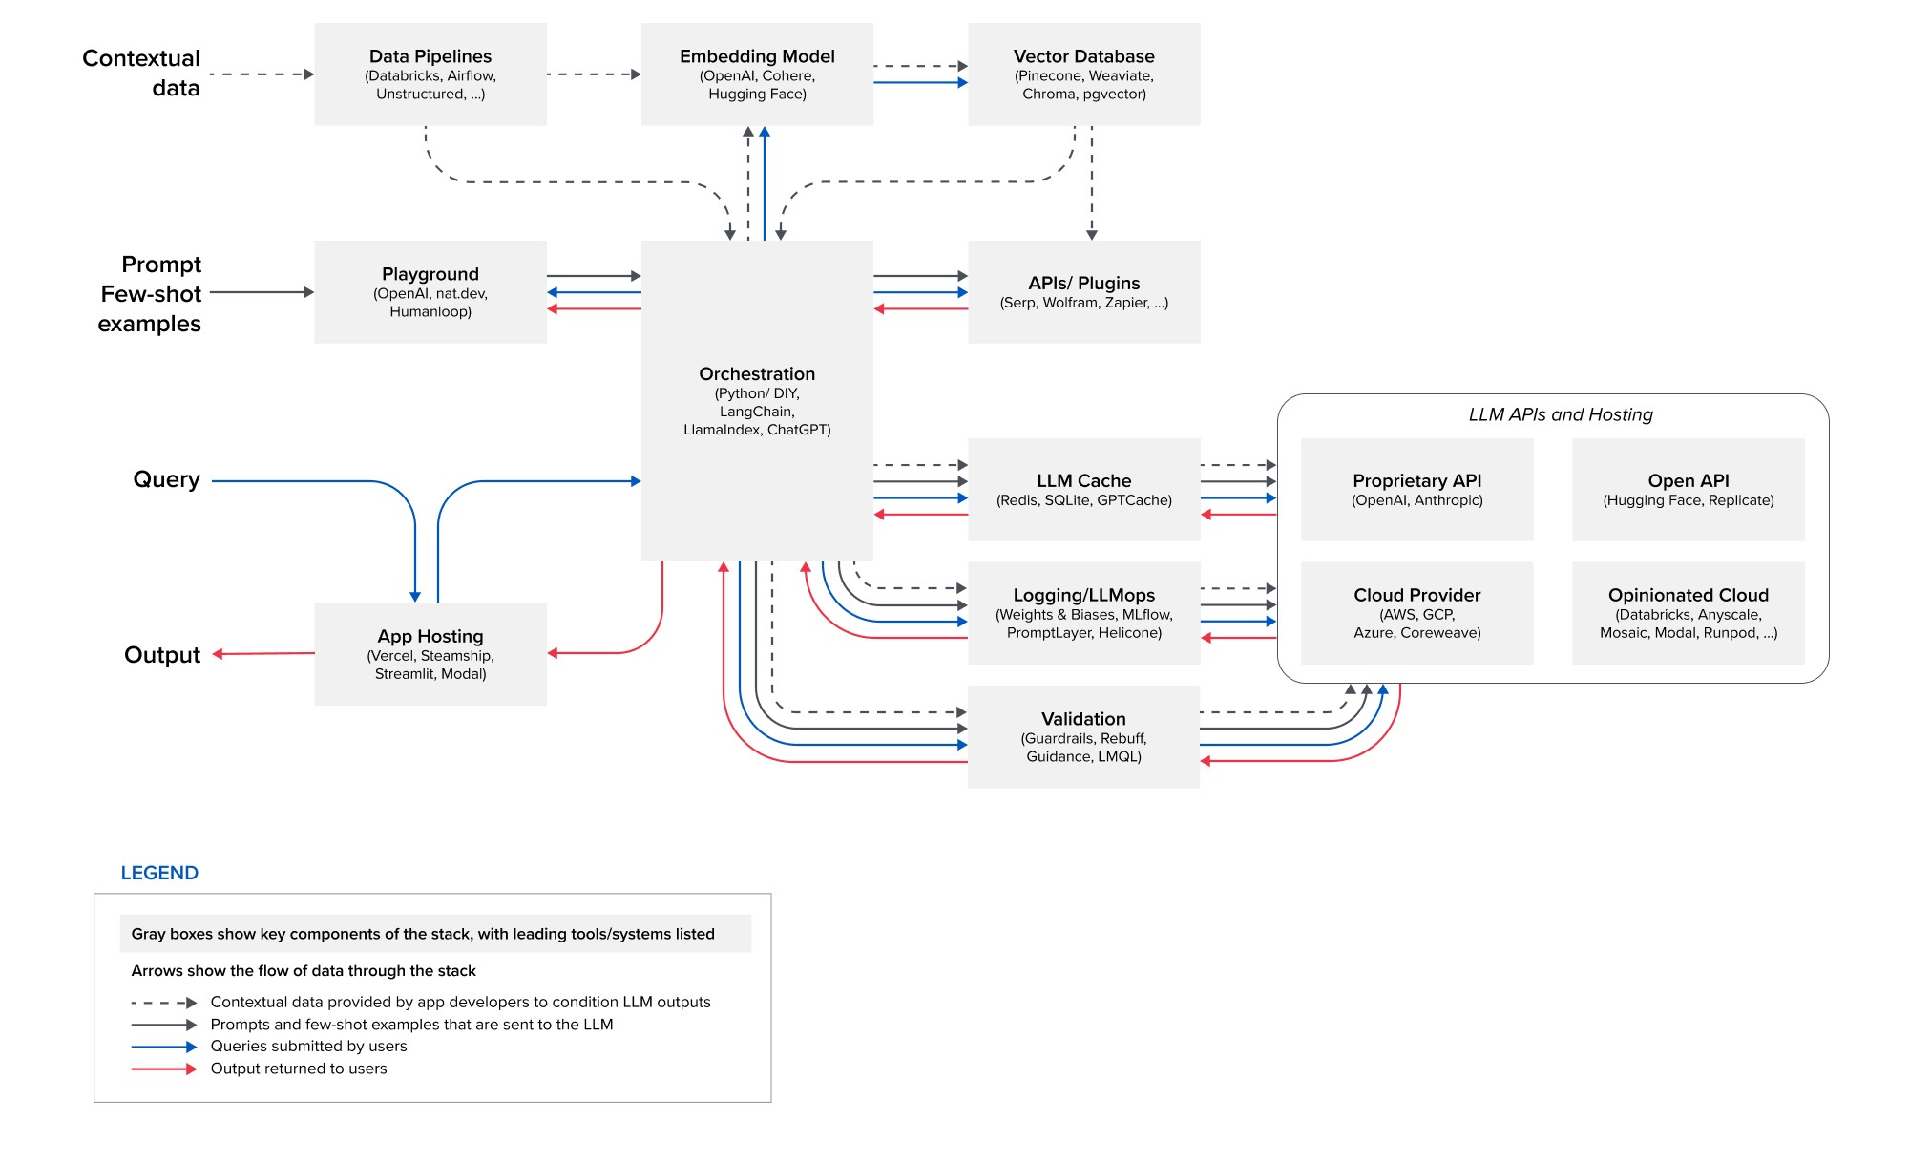
Hld(high level design)

Slide 6
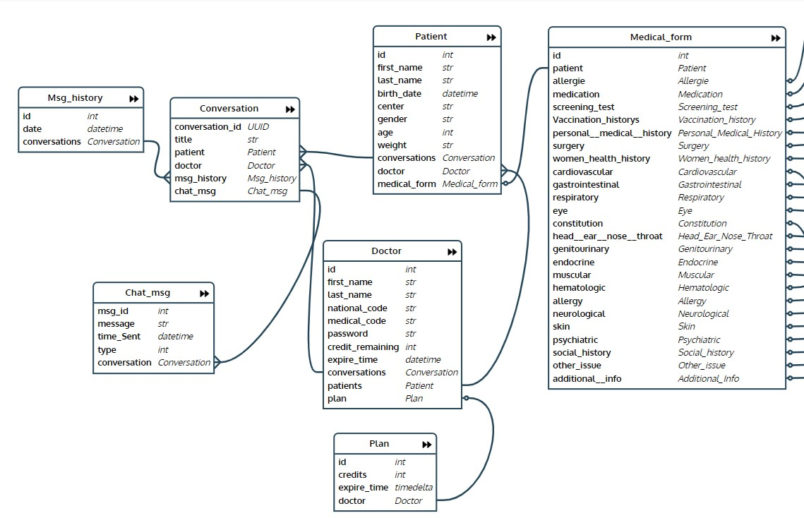
Sql db

Slide 7
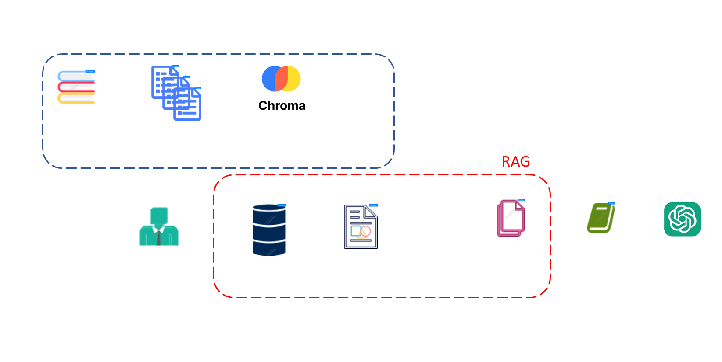
Vector Db

Slide 8


timetable
Task | Time(month) | Done
R&D | 8
MVP | 4
MMP (version 1.0) | 6

Slide 9
customers
1. Individual Doctors
Primary Care Physicians
Specialists
Clinicians
2. Healthcare Organizations
Hospitals and Health Systems
Clinics and Medical Practices

Slide 10
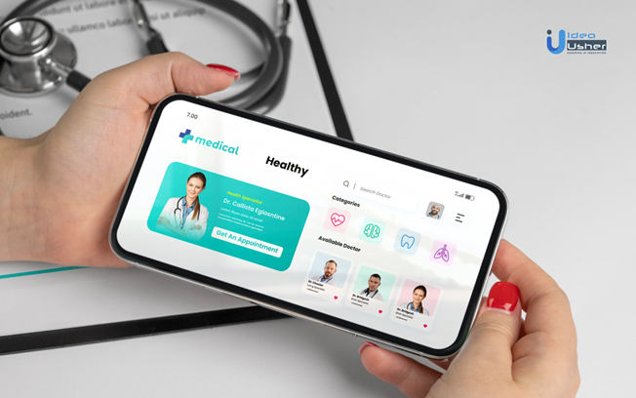
product
AI Doctor Assistant : Raman-AI-Med
Accessibility : Website & APP
Price : $ 150 Annually
advantages and superiority :
Advanced AI-driven Clinical Decision Support
Enhanced Diagnostic Accuracy
Optimized Drug Dosage and Treatment Plans
Improved Patient Outcomes and Safety
Scalability and Customization
Continuous Learning and Improvement

Slide 11
competitor
American company Docus:
Specialized Medical Language Models: )ChatGPT <= MedALPACA | MedPALM(
diagnoses and treatment recommendations
Localization and Adaptation
Integration with Local Healthcare Systems

Slide 12

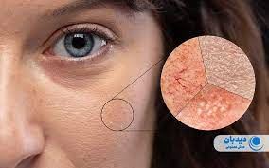
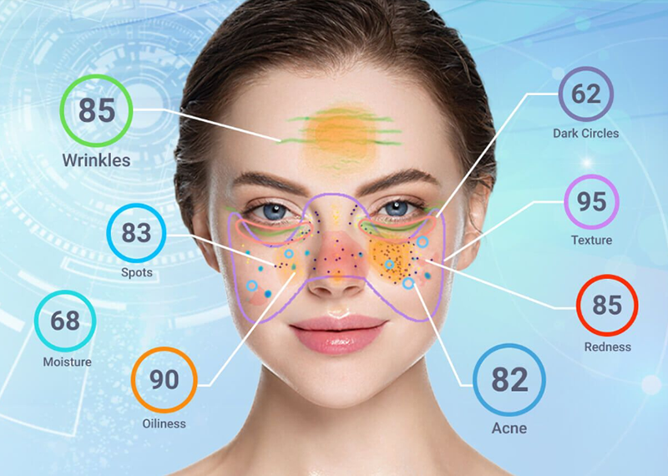
Our future
AI & MEDICINE & BEAUTY
AI

Slide 13
Our team
Mehdi Fakhri (CEO |CTO)
Amin Zibayi (chief financial officer)
Amir Reza Ramezani (backend-AI Developer)
Ali Baratiyan (Physician)
Yekta Nasiripoor (Data scientist)

Slide 14
estimated costs
1. Software Licensing and Subscription Fees:
2. Hardware Infrastructure:
Server infrastructure
Networking equipment
Storage devices
Integration and Interoperability
Training and Support:
Training costs
Support services

Slide 15
Revenue Model
Subscription-based model where physicians, healthcare practices, and hospitals pay a monthly or annual subscription fee to use the AI-powered medical diagnostic and treatment recommendation system.
The proposed subscription fee could be around $15 per physician per month or $150 per physician annually.
Revenue Projections:
Assuming they can acquire 5,000 physician subscribers in the first year by targeting large healthcare systems, private practices, and specialty clinics across the country.
With 5,000 physician subscribers at $150 per year, the projected annual revenue is around $0.75 million.

